Slide 1
BANK MARKETING DATASET ANALYSIS REPORT
by Odunola Adewale
https://github.com/AnalystOdunola
http://linkedin.com/in/odunola-adewale-52a4a8158

Slide 2
PROBLEM STATEMENT
The Business Challenge;
Bank runs term deposit campaigns but conversion is inconsistent across customer segments
Current average conversion rate: 47.4% = 5K Yes out of 11K contacts
Wasted budget on low-performing segments + poor call timing
Core question: Which customers, when, and how should we target to maximize subscriptions and ROI?

Slide 3
DATASET OVERVIEW
Dataset: Bank Marketing Campaign Dataset
Total Customers: 11K+
Total Subscribers: 5K+
Conversion Rate: 47.4%
Average Balance: 1.53K
Average Call Duration: 372 Seconds
Key Variables
Customer Demographics (Age, Job, Education, Marital Status)
Financial Information (Balance, Housing Loan)
Campaign Information (Call Duration, Contact Type, Previous Campaign Outcome)
Deposit Subscription Status (Yes/No)

Slide 4
KEY VISUALIZATIONS
KPI Cards: Conversion Rate, Average Balance, Average Call Duration, Total Customers and Total Subscribers. These provides an executive-level overview of campaign performance.
Bar Charts: Conversion Rate by Job, Balance Segment, and Previous Campaign Outcome. These are used to identify high-performing customer segments and the factors most associated with successful subscriptions.
Donut Chart: Conversion Rate by Duration Bucket (Long vs Short Calls). These highlights the impact of customer engagement and conversation length on conversion success.

Slide 5
KEY VISUALIZATIONS CONTD.
Line Chart: Monthly Conversion Rate Trend. This is used to uncover seasonal patterns and identify periods of high and low campaign performance
Matrix Heatmap: Education × Marital Status × Loan Analysis. This provides a multi-dimensional view of customer segments and how demographic and financial characteristics influence conversion rates.
Slicers: Age Group, Housing Loan Status, and Contact Method . They enable interactive filtering and deeper exploration of campaign performance across different customer demographics and communication channels.
This combination of visuals provides both a high-level performance overview and a detailed analysis of the demographic, financial, behavioral, and campaign factors influencing deposit subscriptions.

Slide 6
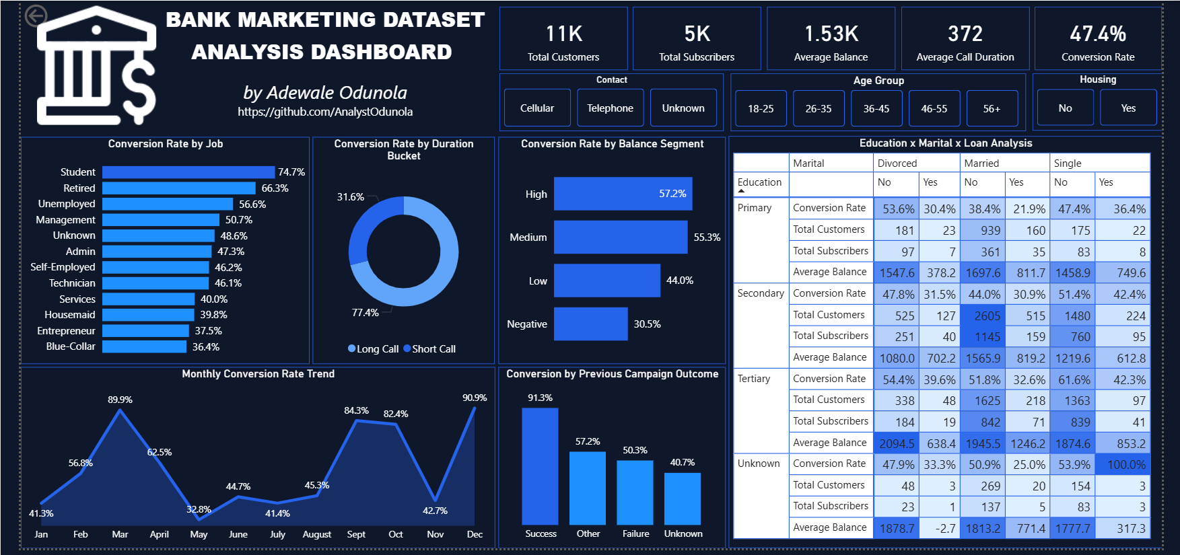
DASHBOARD SCREENSHOT

Slide 7
MAJOR FINDINGS
Segment Performance Gap
Students: 74.7% conversion & Retired: 66.3%
Blue-Collar: 36.4% conversion
Gap: 38.3% between best vs worst job segment
2. Timing Is Everything
Peak months: Mar 89.9%, Dec 90.9%
Low months: May 32.8%, Nov 42.7%
2.7x difference based on month alone

Slide 8
MAJOR FINDINGS CONTD.
3. History Predicts Future
Previous Success: 91.3% conversion
Unknown history: 40.7% conversion
Retargeting past converters = highest ROI
4. Call Duration Drives Results
Long calls >31.6min: 77.4% of conversions
Short calls <31.6min: 22.6% of conversions
5. Financial Capacity
High-balance customers: 57.2% conversion
Negative-balance customers: 30.5% conversion
Customers with stronger financial profiles are more likely to subscribe

Slide 9
RECOMMENDATIONS
Target High-Converting Segments: Reallocate campaign resources toward Students (74.7%) and Retired customers (66.3%), while reducing spend on lower-performing groups such as Blue-Collar (36.4%) and Entrepreneurs (37.5%). A more targeted approach is likely to improve overall campaign efficiency and conversion rates.
Improve Call Quality: Since long calls generate 77.4% of conversions, focus on agent training, customer engagement techniques, and consultative selling. Prioritize meaningful conversations over high call volumes.
Optimize Campaign Timing: Increase campaign activity during high-performing months such as March (89.9%) and December (90.9%), and reduce marketing spend during lower-performing periods like May (32.8%) and November (42.7%) to maximize ROI.

Slide 10
RECOMMENDATION CONTD.
Implement a Retargeting Strategy: Create a dedicated campaign for customers with a previous successful outcome (91.3% conversion rate). These customers represent the highest-probability segment and should be prioritized before acquiring new leads.
Adopt Lead Scoring: Use factors such as account balance, previous campaign outcome, occupation, and loan status to rank prospects. Prioritizing high-balance and historically responsive customers can improve conversion rates and reduce acquisition costs.

Slide 11
CONCLUSION
The analysis proves conversion is driven by who you call, when you call, and their past behavior. It’s not just how many you call. By focusing on Students/Retired segments, optimizing for Mar./Dec. timing and retargeting previous Success customers, the bank can lift conversion from 47.4% to 55%+ while reducing campaign costs. These data-driven actions provide immediate ROI improvement for the next campaign cycle.

